Slide 1
Supervised Learning:Classification
Nearest Neighbor Part-1

Slide 2
Lazy learning:Nearest neighbors
Nearest neighbor classifiers are defined by their characteristic of classifying unlabeled examples by assigning them the class of similar labeled examples.
They have been used successfully for:
Computer vision applications, including optical character recognition and facial recognition in both still images and video

Slide 3
Predicting whether a person will enjoy a movie or music recommendation
Identifying patterns in genetic data, perhaps to use them in detecting specific proteins or diseases

Slide 4
The k-NN algorithm
The nearest neighbors approach to classification is exemplified by the k-nearest neighbors algorithm (k-NN).
The k-NN algorithm gets its name from the fact that it uses information about an example's k-nearest neighbors to classify unlabeled examples.
The letter k is a variable term implying that any number of nearest neighbors could be used.

Slide 5
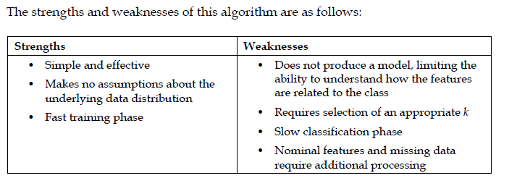

Slide 6
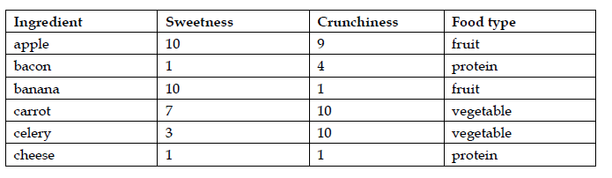

Slide 7
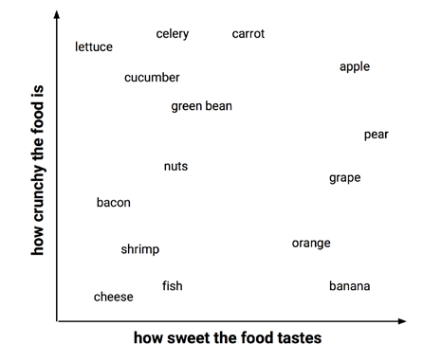

Slide 8
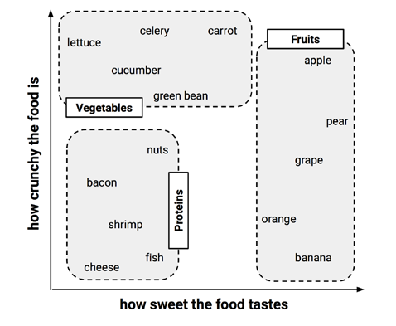

Slide 9
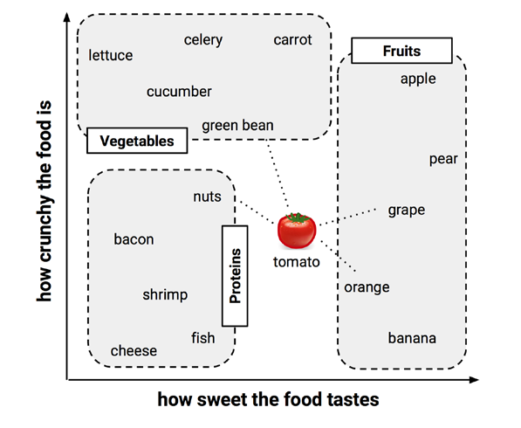

Slide 10
Measuring similarity with distance
Locating the tomato's nearest neighbors requires a distance function, or a formula that measures the similarity between the two instances.
The distance formula involves comparing the values of each feature. For example, to calculate the distance between the tomato (sweetness = 6, crunchiness = 4), and the green bean (sweetness = 3, crunchiness = 7), we can use the formula as follows:

Slide 12
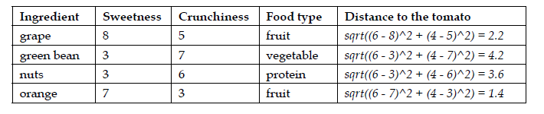

Slide 13
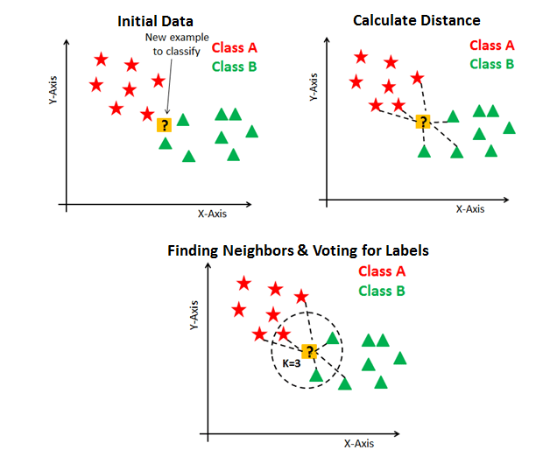
Choosing an appropriate k

Slide 14
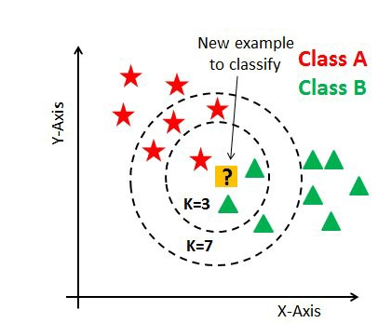

Slide 15
As you can verify from the above image, if we proceed with K=3, then we predict that test input belongs to class B, and if we continue with K=7, then we predict that test input belongs to class A.
That’s how you can imagine that the K value has a powerful effect on KNN performance.
There are no pre-defined statistical methods to find the most favorable value of K.

Slide 16
The small K value isn’t suitable for classification.
The optimal K value usually found is the square root of N, where N is the total number of samples.

Slide 17
Why KNN is Lazy?
K-NN is a lazy learner. A lazy learner is not really learning anything.
An eager learner has a model fitting or training step. A lazy learner does not have a training phase.
There is no training time in K-NN.
This allows the training phase, which is not actually training anything, to occur very rapidly.

Slide 18
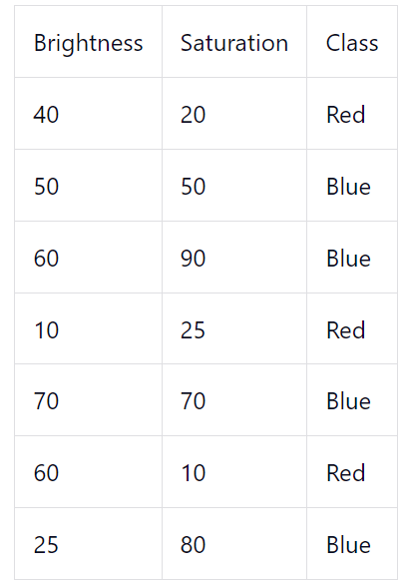
Numerical

Slide 19
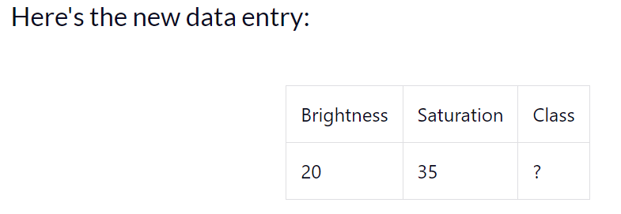
Find the class

Slide 20
